Slide 1

OPERATION ANALYTICS AND INVESTIGATING METRIC SPIKE
SUBMITTED BY: Tanisha Sodani
COURSE: MySQL – Trainity
TOOLS USED: MySQL Workbench, SQL
DATE: JUNE 27, 2025

Slide 2
CONTENT
  Project Description
  Tech Stack Used
  Approach
  Case Study 1: Job Data Analysis
  Case Study 2: Investigating Metric Spike
  Insights
  Result

Slide 3
PROJECT DESCRIPTION
This project focuses on Operational Analytics and Investigating Metric Spikes using Advanced SQL. As a Data Analyst, the goal is to work with different teams to analyze data and provide valuable insights.
The project includes two case studies:
  Case Study 1 – Job Data Analysis: Focuses on analyzing job data to calculate job reviews over time, throughput, language share, and identify duplicate rows.
  Case Study 2 – Metric Spike Investigation: Involves investigating sudden changes in key user metrics such as user engagement, growth, retention, device-wise activity, and email interaction.
The main objective is to write SQL queries to extract insights from the data and present them in a simple and clear report.

Slide 4
TECH-STACK USED
💻 MySQL Workbench
I used MySQL Workbench to write and execute all the SQL queries throughout the project. Its user-friendly interface made it easy to manage the database, visualize the data, and debug queries effectively.
🗂️ SQL (Structured Query Language)
SQL was the main tool I used for retrieving, filtering, and analyzing data. It helped me answer business questions by writing precise and well-structured queries that turned raw data into meaningful insights.

Slide 5
APPROACH
Step-by-step process followed:
📁 Imported the CSV files and set up the tables in MySQL Workbench
🛠️ Wrote SQL queries to solve each task from both case studies
📊 Analyzed query results to identify trends, spikes, and patterns
🧠 Explored user behavior and performance metrics to find key insights
🖼️ Took screenshots of SQL queries and output tables for documentation
📝 Summarized insights and organized the findings into a clear report

Slide 6
CASE STUDY 1: JOB DATA ANALYSIS

Slide 7
JOBS REVIEWED OVER TIME
OVERVIEW
🔹Objective:
Calculate the number of jobs reviewed per hour for each day in November 2020.
🔹Observation:
  The ds column only contains date (MM/DD/YYYY) format as text.
  There’s no timestamp (hour-level) data in the dataset. So, hourly analysis isn't possible.
🔹Alternative Approach:
Performed a daily review count instead, focusing on event = 'decision' to represent reviewed jobs.
🔹SQL Handling:
Used STR_TO_DATE(ds, '%m/%d/%Y') to convert the text date into proper DATE format for filtering and grouping.

Slide 8
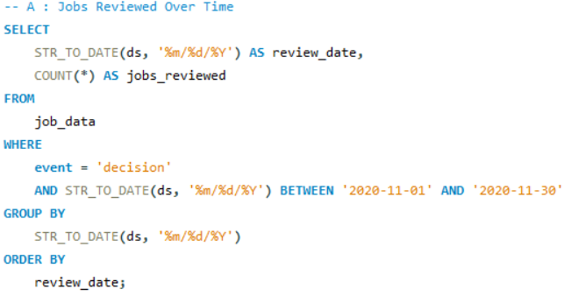
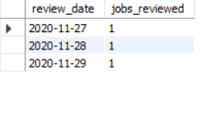
JOBS REVIEWED OVER TIME
SQL & INSIGHT
SQL Query Used:
Output:
🔹Insight:
  Jobs were reviewed only on 3 days: November 27, 28, and 29.
  This indicates low review activity during the month.
  While hourly trends couldn’t be analyzed, this daily view helps identify patterns and inactive periods.

Slide 9
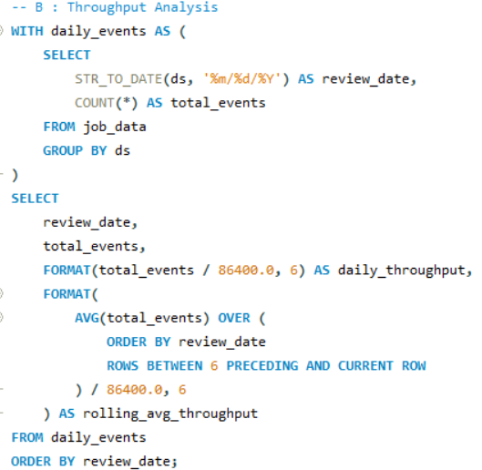
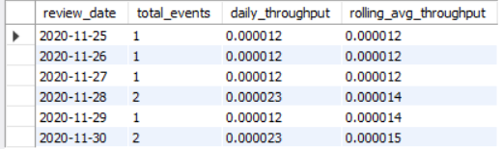
THROUGHPUT ANALYSIS
🔹Objective:
Calculate the 7-day rolling average of throughput (number of events per second) for each day.
SQL Query Used:
Output:
💡Insight:
The rolling average made it easier to see how throughput was really performing, without getting distracted by sudden daily changes.

Slide 10
THROUGHPUT ANALYSIS –
PREFERRED METRIC
I prefer the 7-day rolling average over the daily metric because:
📉 It reduces the impact of random daily spikes or drops
📊 Shows a smoother and more consistent performance trend
📈 Helps identify long-term patterns more effectively
🧠 Provides a more reliable view for operational decision-making

Slide 11
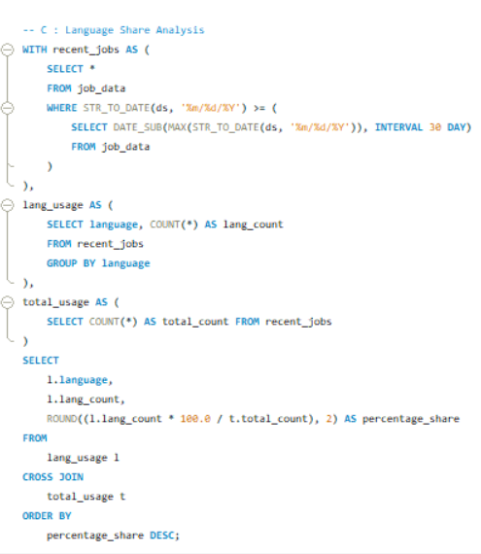
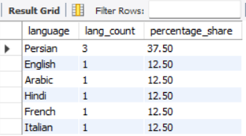
LANGUAGE SHARE ANALYSIS
🔹Objective:
Calculate the percentage share of each language in the last 30 days of available data.
SQL Query Used:
Output:
💡Insight:
Persian had the highest share at 37.5%, while English, Arabic, Hindi, French, and Italian each had 12.5%, showing Persian was the most used language recently.

Slide 12
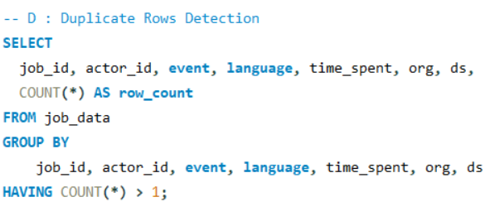
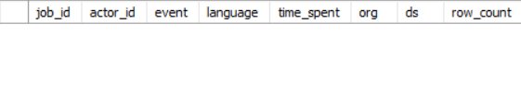
DUPLICATE ROWS DETECTION
🔹Objective:
Identify duplicate rows in the job_data table.
SQL Query Used:
Output:
💡Insight:
No duplicate rows were found in the dataset. This indicates that the data is clean and well-maintained, reducing the risk of repeated records affecting analysis results.

Slide 13
CASE STUDY 2: INVESTIGATING METRIC SPIKE

Slide 14
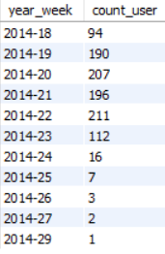
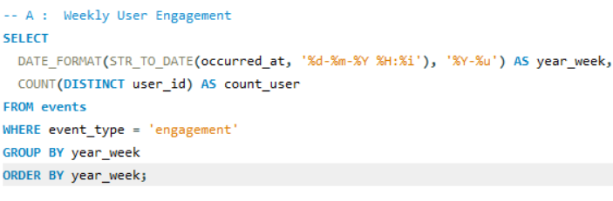
WEEKLY USER ENGAGEMENT:
🔹Objective:
Measure the activeness of users on a weekly basis.
SQL Query Used:
Output:
💡Insight:
User engagement varied each week, helping identify when users were more or less active on the platform.

Slide 15
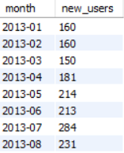
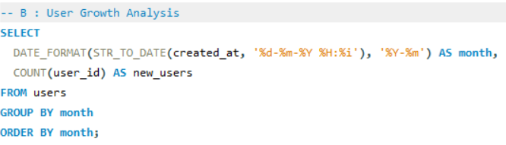
USER GROWTH ANALYSIS
🔹Objective:
Analyze the growth of users over time for a product.
SQL Query Used:
Output:
💡Insight:
This shows how many new users joined each month. It helps understand when user growth was high and when it slowed down, giving a clear picture of the platform’s growth over time.

Slide 16
WEEKLY RETENTION ANALYSIS
OVERVIEW & LIMITATION
🔹Objective:
Analyze the retention of users on a weekly basis after signing up for a product.
🔹Note:
Due to mismatched user_id values between the users and events tables, actual retention analysis could not be performed.
🔹What I Would Have Done (Logic)
  Grouped users by their signup week (cohort)
  Tracked their activity in the weeks after signup
  Calculated how many returned each week
💡Insight:
This approach shows how long users stay active after joining, helping measure user stickiness and product impact over time.

Slide 17
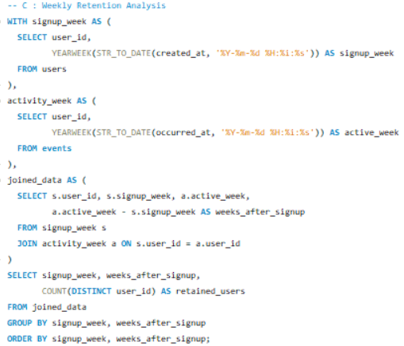
WEEKLY RETENTION ANALYSIS
SQL LOGIC
📝 This query explains how retention would be calculated if the user data matched across tables.
SQL Query Used:

Slide 18
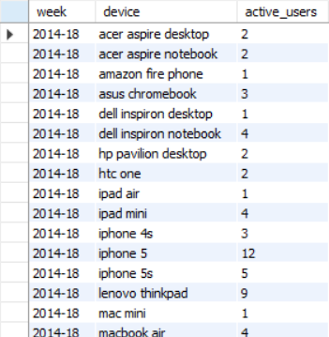
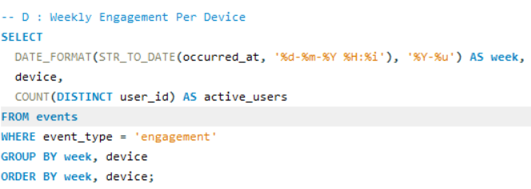
WEEKLY ENGAGEMENT PER DEVICE:
🔹Objective:
Measure the activeness of users on a weekly basis per device.
📝 Note:
This is a sample from week 2014-18 to show the format. The full output includes multiple weeks and device types.
SQL Query Used:
Output:
💡Insight:
Users engaged with the platform using a variety of devices - mobile, desktop, and tablet.

Slide 19
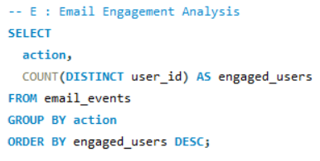

EMAIL ENGAGEMENT ANALYSIS
🔹Objective:
Analyze how users are engaging with the email service.
SQL Query Used:
Output:
💡Insight:
Many users opened the emails, but fewer clicked on them. This shows there’s room to improve email content or subject lines to boost engagement.

Slide 20
INSIGHTS
Key Takeaways from the Analysis:
  Hourly analysis wasn’t possible due to missing timestamps in the job_data table, but reviews only occurred on 3 days - showing very low activity.
  The 7-day rolling average provided a smoother and more accurate performance view.
  Persian had the highest language share, with five other languages equally used.
  No duplicate rows were found - the data was already clean.
  User engagement changed weekly, highlighting active and quiet periods.
  Users accessed the platform from mobile, desktop, and tablet devices.
  User sign-ups showed steady growth over time.
  Retention couldn’t be measured due to unmatched user IDs, but the logic was clearly understood.

Slide 21
RESULT
What I learned through this project:
  I used SQL to answer real business questions and solve practical problems.
  I learned how to find trends in user activity, growth, and engagement.
  I practiced writing advanced queries like rolling averages and retention logic.
  I got better at working with different tables and handling data issues.
  This project made me more confident in using data to understand and explain what’s happening.

Slide 22
THANK YOU

